Slide 1

Spatial Proteomics/Transcriptomics with Nanostring GeoMx Digital Spatial Profiler
THEO LASSALE
INSTITUT CURIE, INSERM U900, MINES PARISTECH

Slide 2
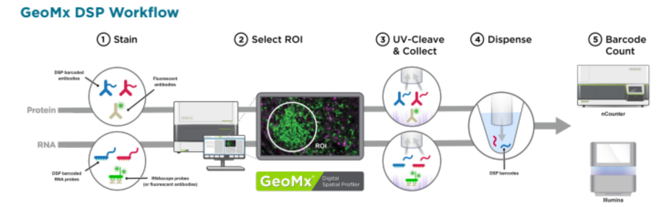
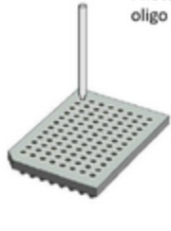
What is GeoMx DSP designed for and how it works ?
What does it achieve?
It can profile gene and protein expression of tissue sections while keeping the spatial information.
From a tissue section to data: How ?
96-well plate

Slide 3
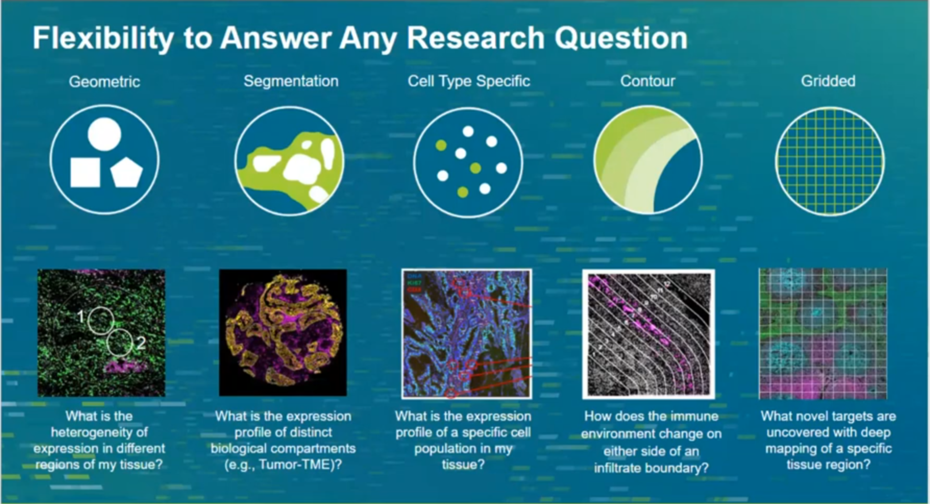
GeoMx DSP ROI Selection

Slide 4
GeoMx DSP Data Analysis
2 choices:
GeoMx Data Analysis Suite (DSPDA) → QC, Normalization, Statistical Analysis, Visualization.
Import count matrix into R.

Slide 5
GeoMx DSP Data Analysis: QC and normalization
Step 1: Quality Control (QC)
QC of ROI
Purpose: Identify and remove ROIs with low target detection (i.e. with poor data). Keep segments with a specified frequency of targets above an expression threshold.
QC of targets
Purpose: Identify and remove targets with low detection across segments. Keep targets with an expression above than an expression threshold, at a specified frequency.
—> Important point: Filtering targets after filtering segments to avoid losing relevant biology.
Step 2: Normalization
Purpose: Choose the right normalization strategy to remove technical variability from the data. There are 4 choices
choices for normalization (housekeeper, background, region or nuclei normalization).

Slide 6
GeoMx DSP Data Analysis: Data exploration
Several data visualization methods…
Heatmap, boxplot, bar graphs —> distribution of expression/cell type deconvolution.
Volcano plot —> statistical changes in expression between expt groups.

Slide 7
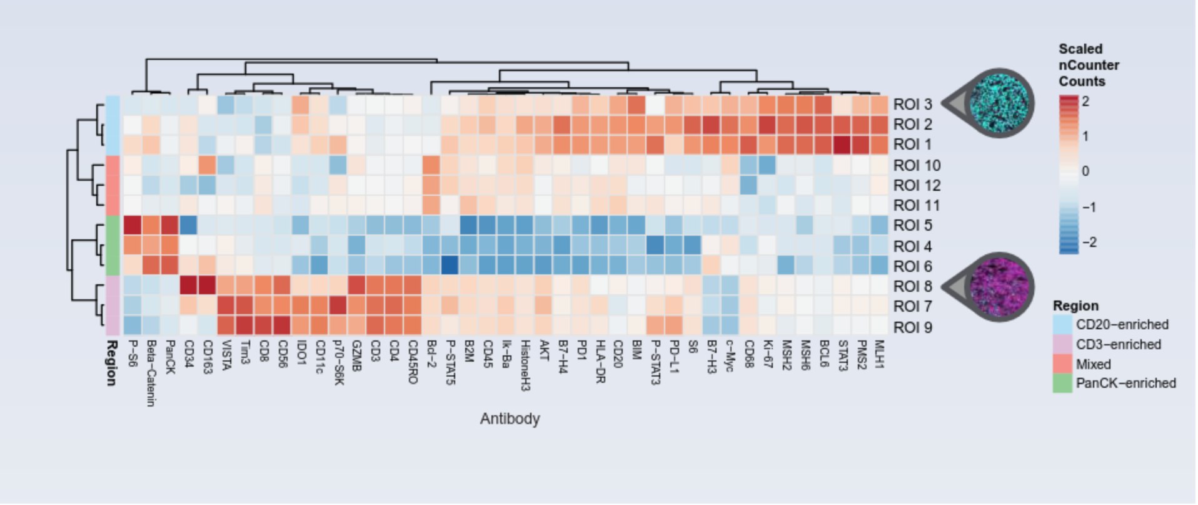
Data Views (Heatmap)

Slide 8
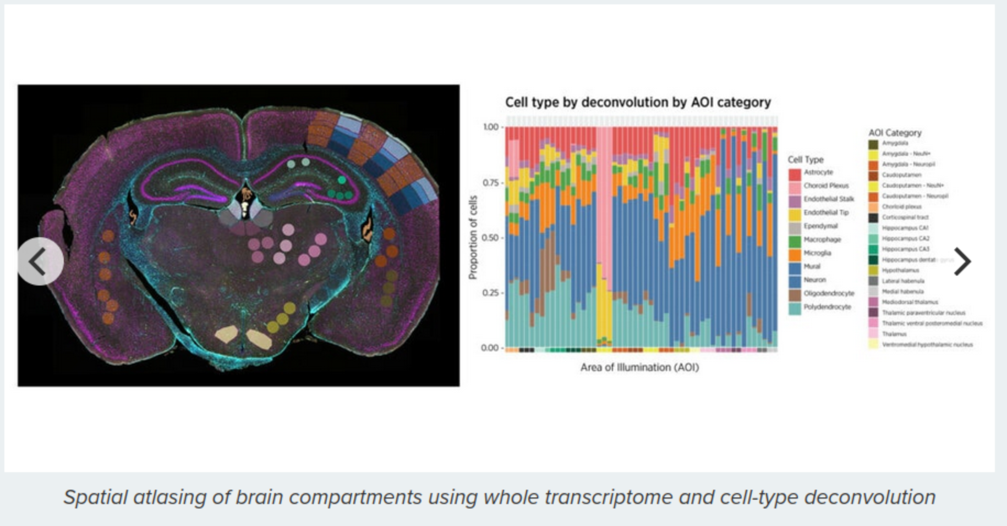
Data Views (Stacked bar chart)

Slide 9
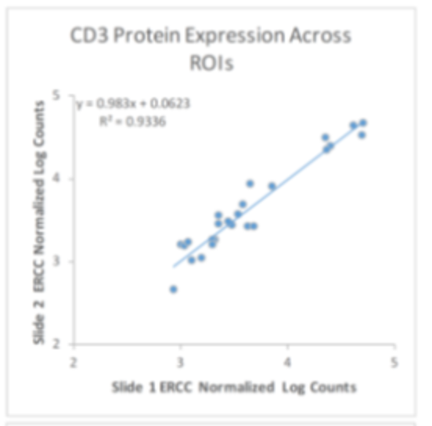
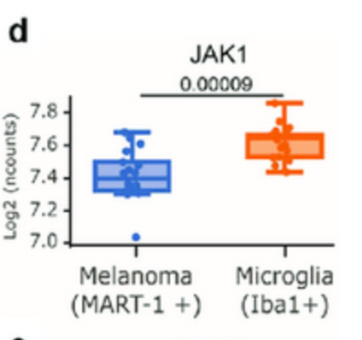
Data Views (Scatter plot and Boxplot)
Scatter plot (with regression line)
Boxplot (expression of JAK1 across MART-1 and Iba-1 positive ROIs) - (Izraely et al., 2023)

Slide 10
GeoMx DSP Data Analysis: Statistical tests for DEA
How to choose the right statistical test for differential expression ?
If 2 ROIs to compare:
Same patient: paired t-test (if data skewed: Wilcoxon)
Two independent patients: unpaired t-test (if data skewed: Mann-Whitney U).
If multiple ROIs to compare:
Linear mixed effect model (LMM) —> batch-effect correction.

Slide 11
GeoMx DSP few assets and a major limitation
Directly counting mRNA and protein molecules (no reverse transcription and PCR amplification) ---> no bias in expression data.
Spatially profile the whole transcriptome of human and mouse and +570 protein targets separately or simultaneously .
Can process more than 10 tissue sections per day.
Flexibility with which you can select profiling regions.
Data analysis software embedded in DSP ---> interface displays both profiling data and imaging data (see slides 12 and 13).
Many biological applications (see slide 14).
Main Limitation
Inability to provide single cell segment resolution ---> cannot quantify gene/protein expression over a single cell —> CosMx SMI (but limited throughput: up to 1000 RNAs or up to 100 proteins).

Slide 12
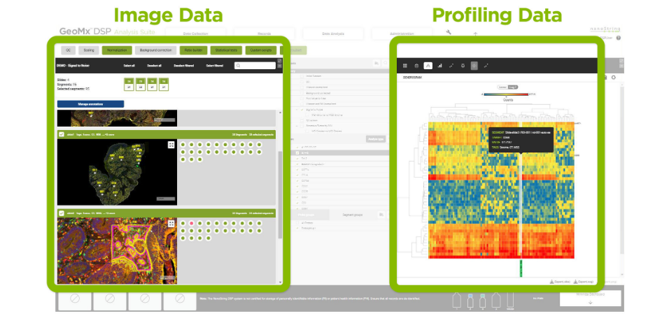
Users of the DSP Data Analysis suite can interact with either dataset (image and profiling data) in real time (1)

Slide 13
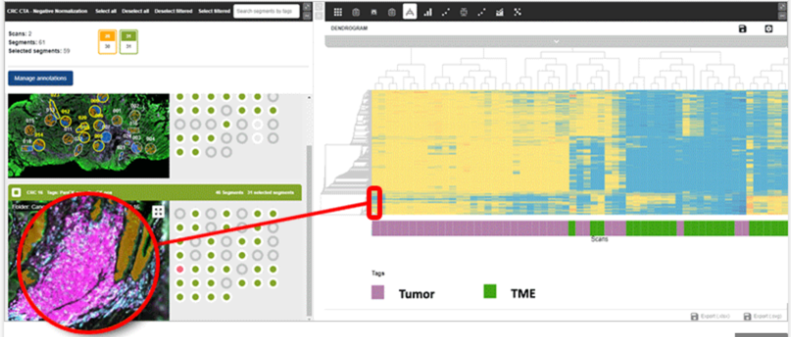
Users of the DSP Data Analysis suite can interact with either dataset (image and
profiling data) in real time (2)

Slide 14


Slide 15
Example of GeoMx DSP application: Neoadjuvant immune checkpoint blockade in high-risk resectable melanoma (Amaria et al., 2018).
Background:
treatment with ICB (Immune checkpoint blockade) in the neoadjuvant setting for patients with high-risk resectable melanoma has not been well studied.
Methods and materials:
Stratified randomized trial of 23 patients with stage III or metastatic stage IV melanoma —> 12 received neoadjuvant nivolumab and 11 received neoadjuvant nivolumab+ipilimumab.
Baseline + early on-treatment sampling —> GeoMx DSP profiling.
Results:
nivolumab+ipilimumab vs nivolumab —> improved OS, PFS, MFS.
In each treatment group, patients responded better than others (‘responders’ vs ‘non-responders’) —> Baseline + Treatment = higher expression of lymphoid markers (Granzyme B, CD4, FoxP3, CD20, and PD-1) + PD-L1 + higher CD8+ T-cell infiltrate.

Slide 16
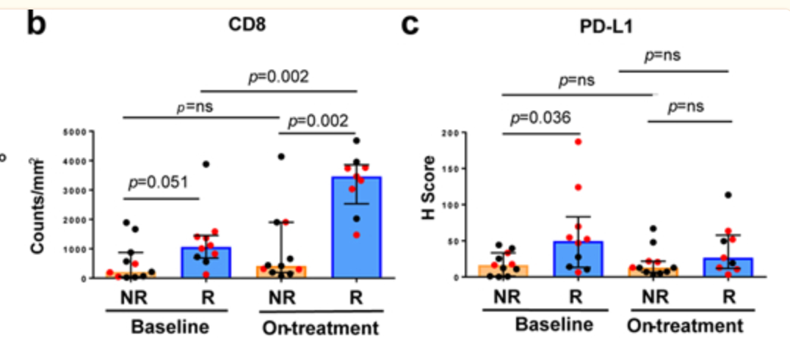
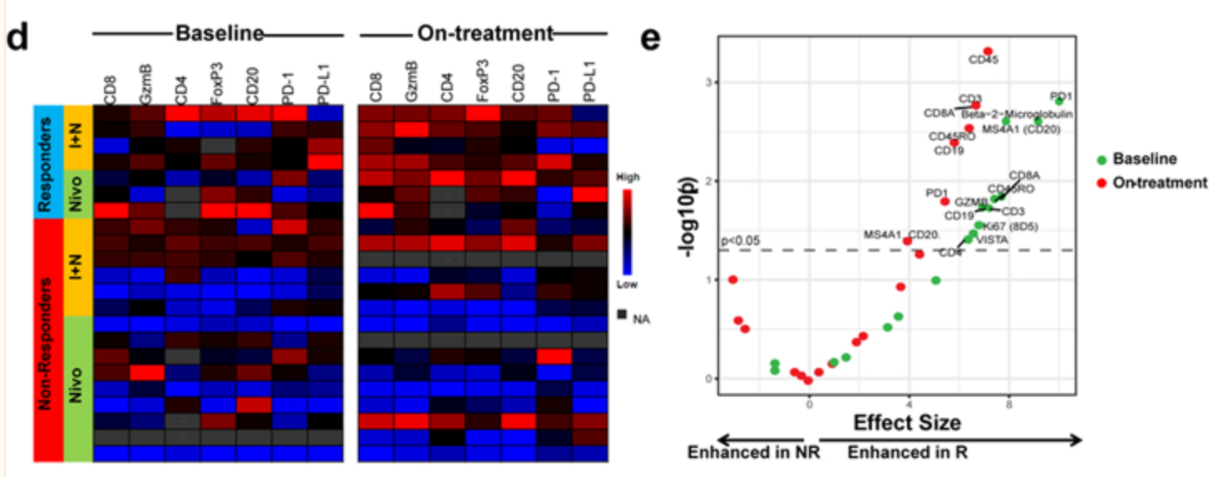
b: CD8 cell count density higher in responders than in non-responders at baseline and early on-treatment.
c: PD-L1 expression greater in responders than in non-responders at baseline and early on-treatment .
d: greater expression of lymphoid markers (Granzyme B, CD4, FoxP3, CD20, and PD-1) in responders than in non-responders at baseline and early-on treatment.
e: immune markers expression significantly (p.value < 0.05) greater in responders than in non-responders both at baseline and early on-treatment.

Slide 17
Conclusion: Use of GeoMx
Biomarkers that can be used to predict the response to neoadjuvant ICB in patients with high-risk resectable melanoma ?
Limitations
Small sample size (only 23 patients).
Early closure of the trial → nivolumab: 2 patients with local progression preventing surgical resection and nivo+ipil: 8 patients with grade 3 treatment-related adverse events (trAEs).
Inclusion of metastatic stage IV disease patients —> decreases generalizability of the results to a stage III population.
Bias attributed to the melanoma subtype —> findings apply for other subtypes than cutaneous ? mucosal ? acral ?

Slide 18
Thank you for your attention !​

Slide 19
Limitations
Small sample size (only 23 patients).
Early closure of the trial → nivolumab: 2 patients with local progression preventing surgical resection and nivo+ipil: 8 patients with grade 3 treatment-related adverse events (trAEs).
Inclusion of metastatic stage IV disease patients —> decreases generalizability of the results to a stage III population.
Bias attributed to the melanoma subtype —> findings apply for other subtypes than cutaneous ? mucosal ? acral ?

Slide 20
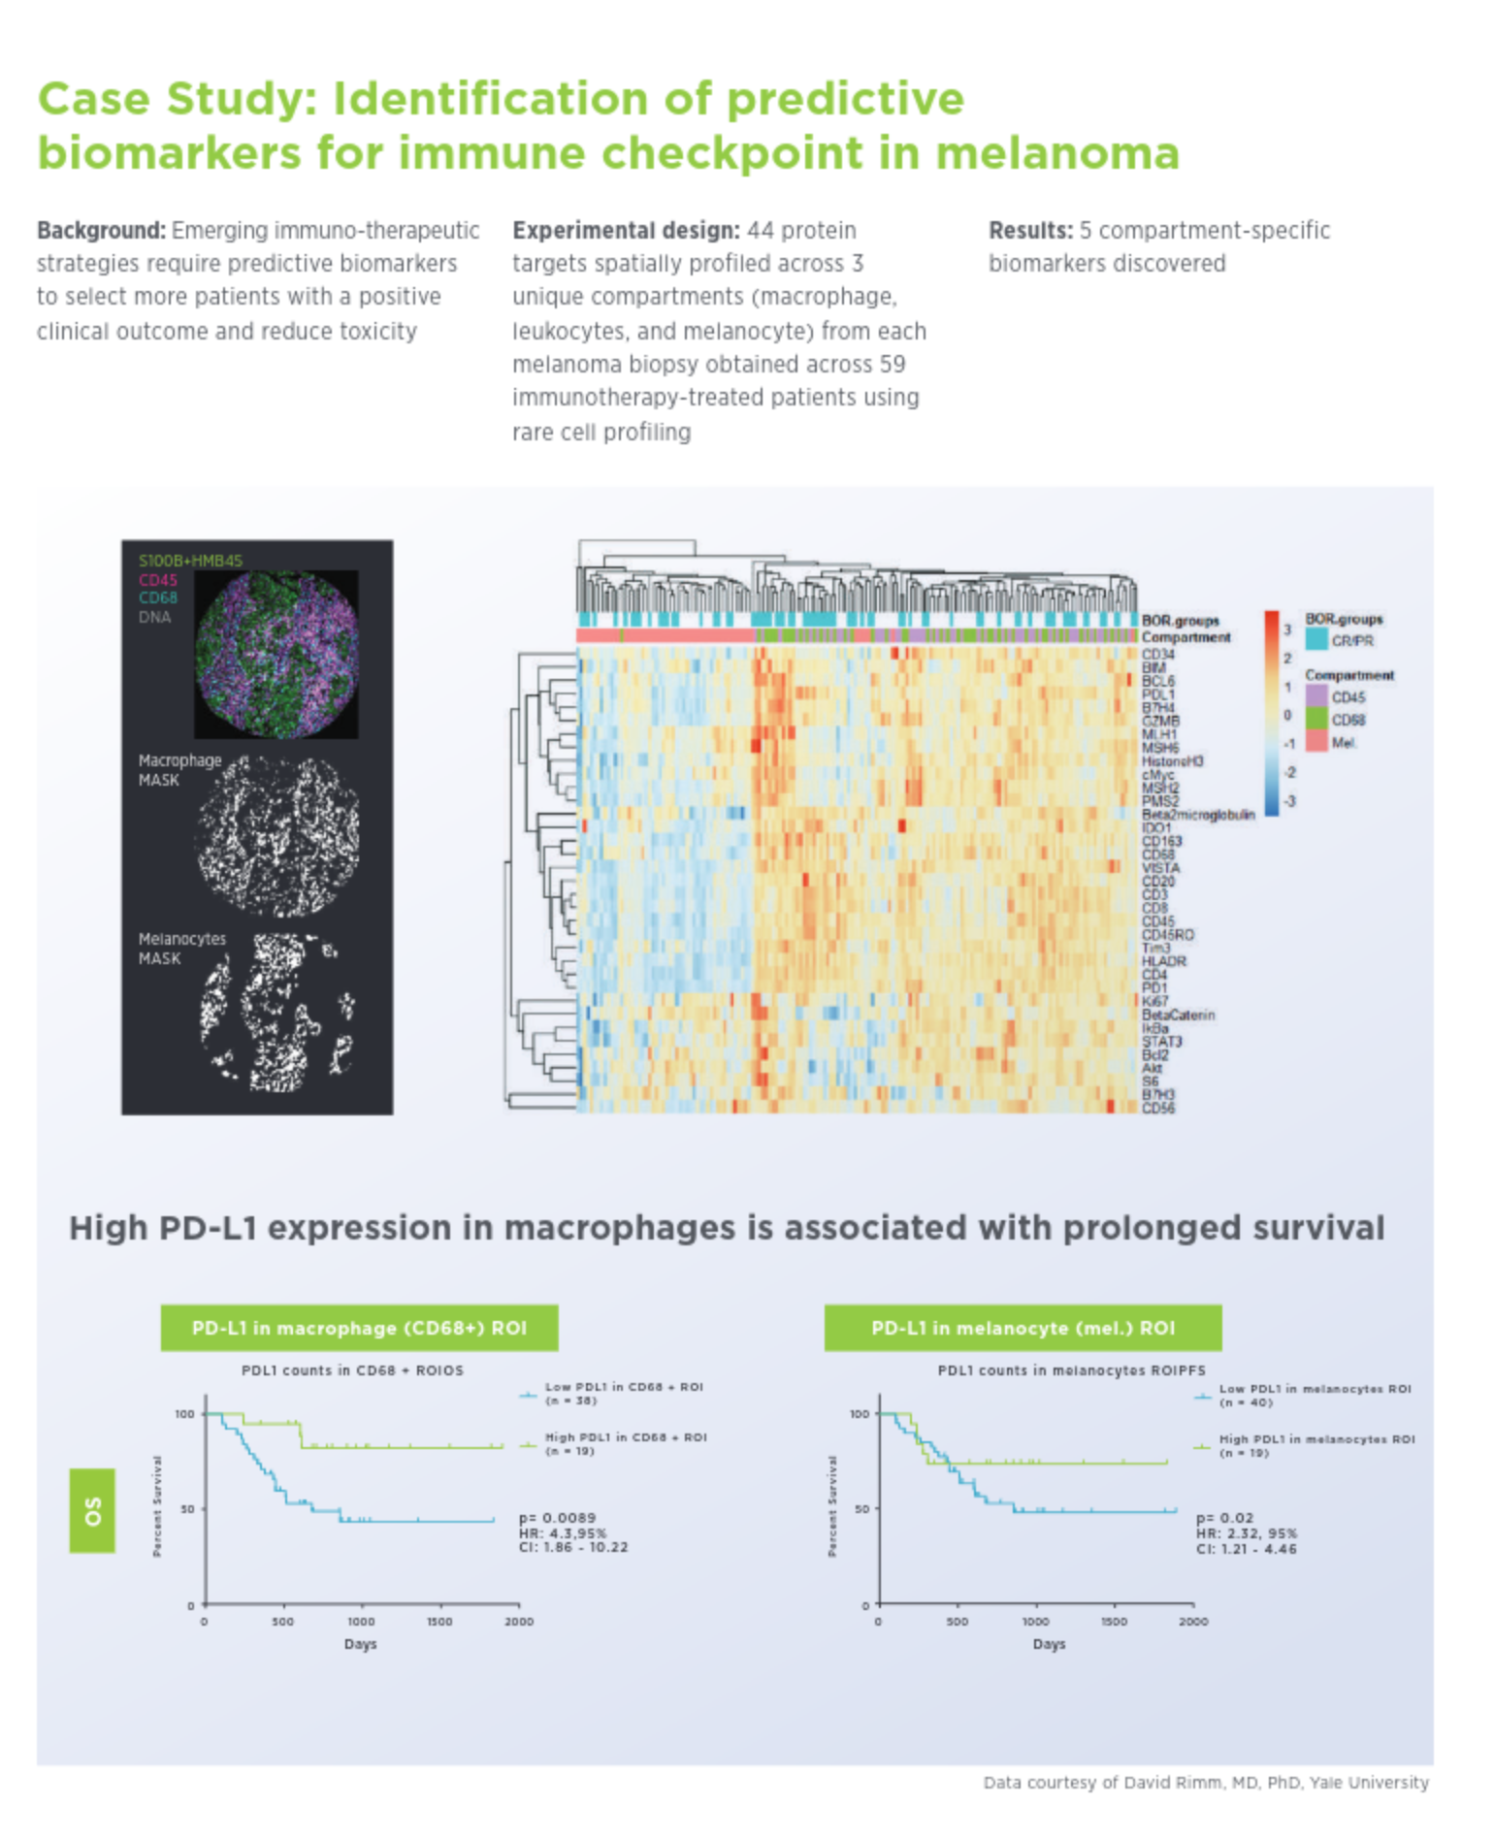
Readings
Walker JM, Orr ME, Orr TC, Thorn EL, Christie TD, Yokoda RT, Vij M, Ehrenberg AJ, Marx GA, McKenzie AT, Kauffman J, Selmanovic E, Wisniewski T, Drummond E, White CL 3rd, Crary JF, Farrell K, Kautz TF, Daoud EV, Richardson TE. Spatial proteomics of hippocampal subfield-specific pathology in Alzheimer's disease and primary age-related tauopathy. Alzheimers Dement. 2024 Feb;20(2):783-797. doi: 10.1002/alz.13484. Epub 2023 Sep 30. PMID: 37777848; PMCID: PMC10916977.
Bergholtz H, Carter JM, Cesano A, Cheang MCU, Church SE, Divakar P, Fuhrman CA, Goel S, Gong J, Guerriero JL, Hoang ML, Hwang ES, Kuasne H, Lee J, Liang Y, Mittendorf EA, Perez J, Prat A, Pusztai L, Reeves JW, Riazalhosseini Y, Richer JK, Sahin Ö, Sato H, Schlam I, Sørlie T, Stover DG, Swain SM, Swarbrick A, Thompson EA, Tolaney SM, Warren SE, On Behalf Of The GeoMx Breast Cancer Consortium. Best Practices for Spatial Profiling for Breast Cancer Research with the GeoMx® Digital Spatial Profiler. Cancers (Basel). 2021 Sep 4;13(17):4456. doi: 10.3390/cancers13174456. PMID: 34503266; PMCID: PMC8431590.
Lothert, P.K., Fedyshyn, B., Girard, S. et al. Spatial proteomics reveals phenotypic and functional differences in T cell and macrophage subsets during villitis of unknown etiology. Sci Rep 14, 914 (2024). https://doi.org/10.1038/s41598-024-51545-2.
Brady, L., Kriner, M., Coleman, I. et al. Inter- and intra-tumor heterogeneity of metastatic prostate cancer determined by digital spatial gene expression profiling. Nat Commun 12, 1426 (2021). https://doi.org/10.1038/s41467-021-21615-4.
Bonnett SA, Rosenbloom AB, Ong GT, Conner M, Rininger ABE, Newhouse D, New F, Phan CQ, Ilcisin S, Sato H, Lyssand JS, Geiss G, Beechem JM. Ultra High-plex Spatial Proteogenomic Investigation of Giant Cell Glioblastoma Multiforme Immune Infiltrates Reveals Distinct Protein and RNA Expression Profiles. Cancer Res Commun. 2023 May 3;3(5):763-779. doi: 10.1158/2767-9764.CRC-22-0396. PMID: 37377888; PMCID: PMC10155752.

Slide 21
Sample Preparation
On a single tissue section (FFPE or fresh frozen tissue), manually or automatically, are combined:
Imaging reagents (fluorescent antibodies or RNAscope probes) to stain the tissue and aid in selecting the regions we want to profile. Up to 4 color-imaging ---> up to 4 antibodies.
Profiling reagents (barcoded antibodies or barcoded RNA probes). The oligo tags are attached to the antibodies/RNA probes via a UV-photocleavable linker. These reagents allow the quantification of proteins/mRNA in the region of interest.

Slide 22
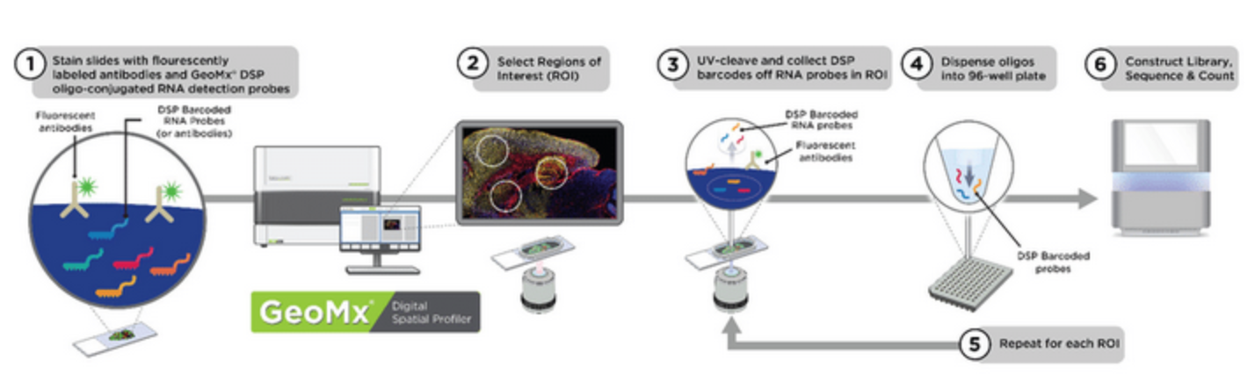
GeoMx DSP workflow (graphic)

Slide 23
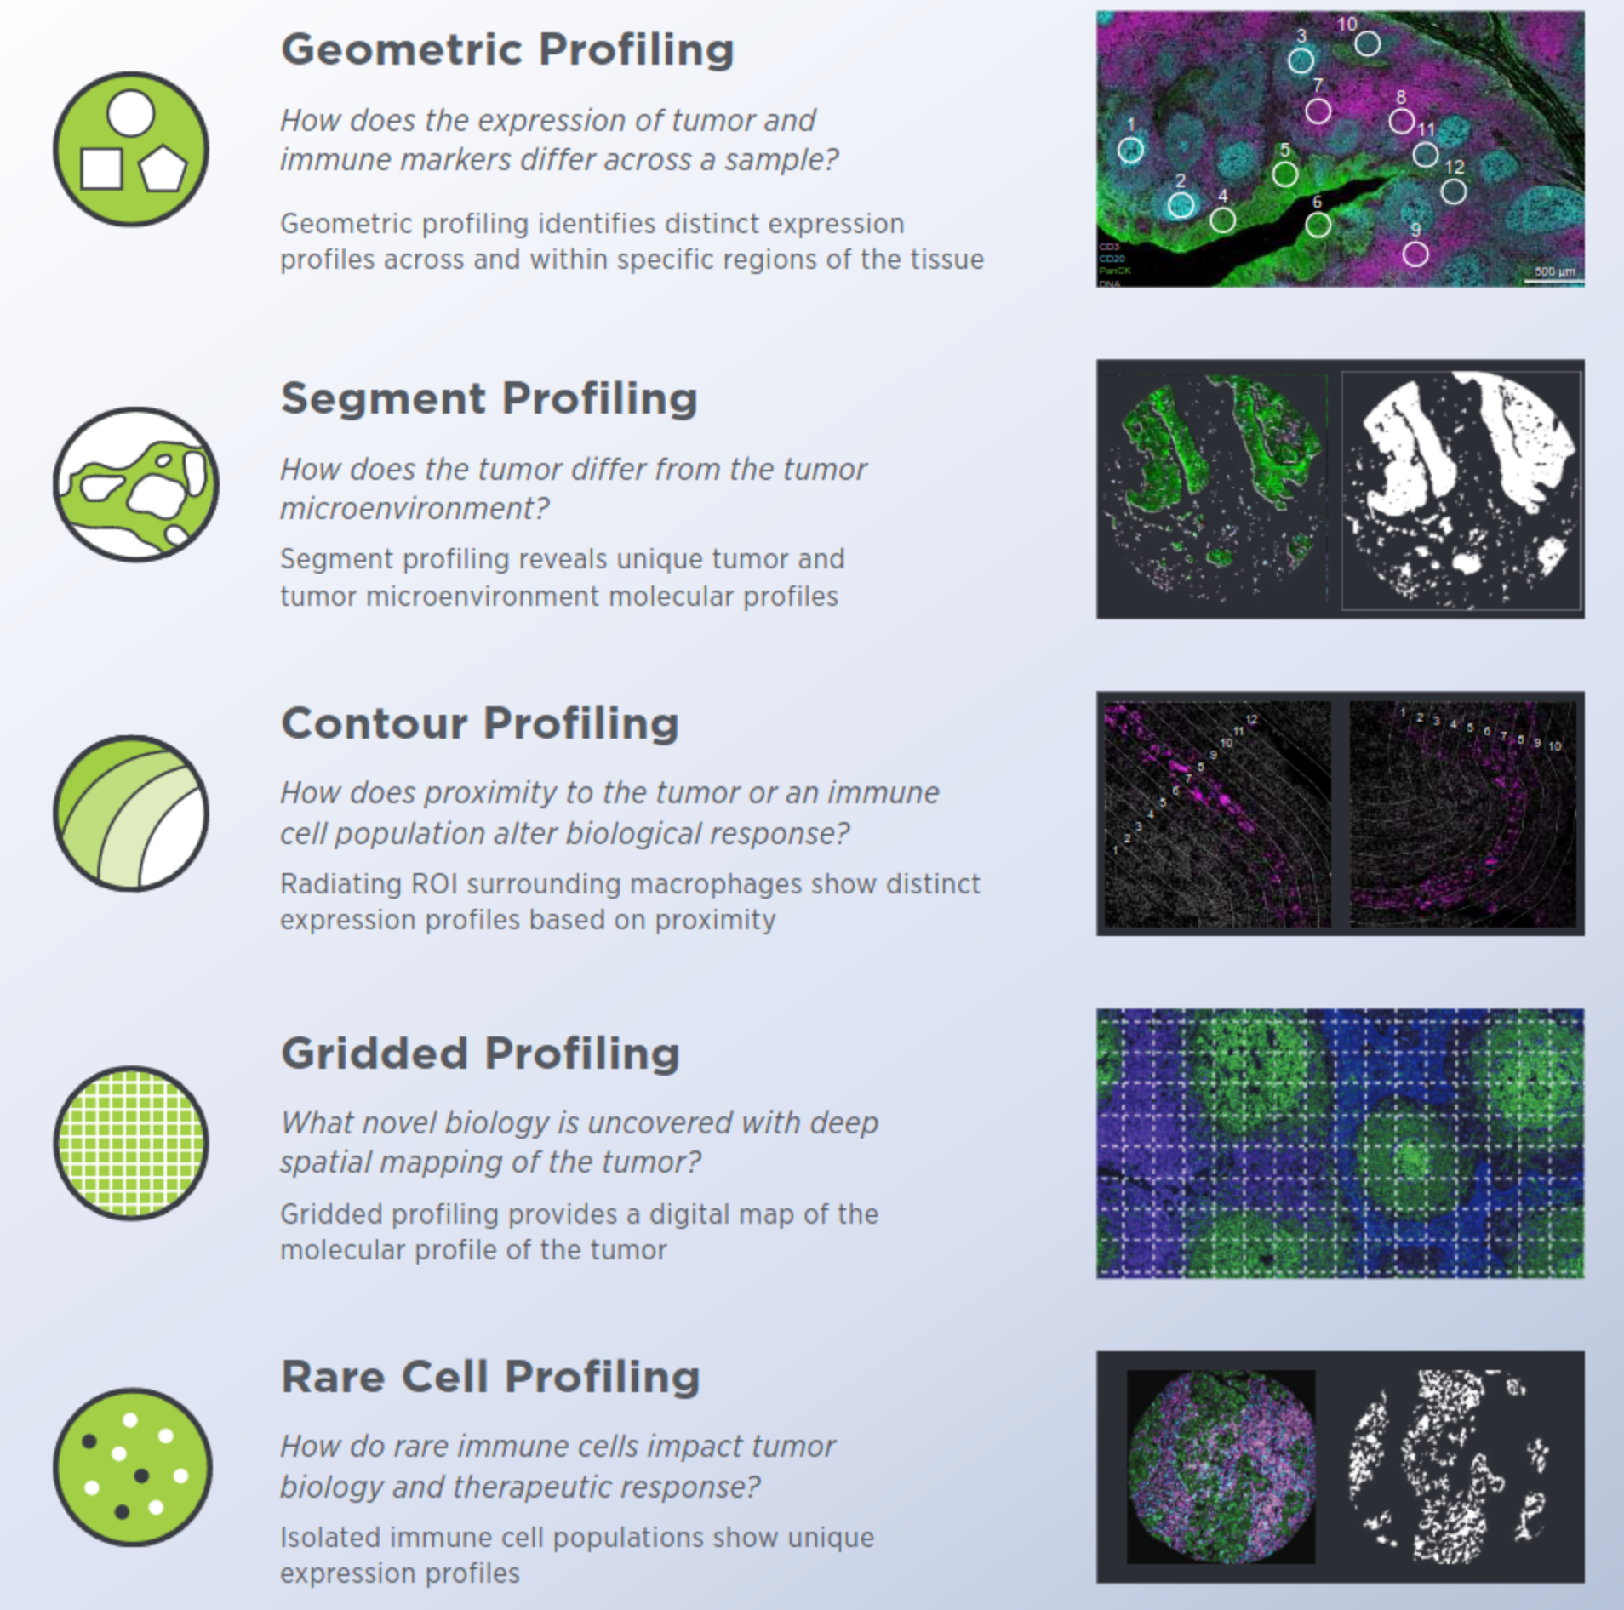
GeoMx DSP ROI Selection

Slide 24
GeoMx DSP Data Analysis (1)
Step 1: Quality Control (QC)
QC of ROI
Purpose: Identify and remove ROIs with poor data, that are low in signal relative to background. Signal = counts of positive targets (i.e. proteins of interest). Background = counts of negative targets (i.e. negative controls).
QC of targets
Purpose: Identify and remove targets with low detection across segments. Keep targets with an expression above than an expression threshold, at a specified frequency.
Step 2: Normalization
Purpose: Choose the right normalization strategy to remove technical variability from the data. There are 4 choices
choices for normalization (housekeeper, background, region or nuclei normalization).

Slide 25
GeoMx DSP Data Analysis (2)
Step 3: Statistical analysis
Purpose: Choose the right statistical test for differential expression.
If 2 ROIs to compare:
Example: - Tumor vs Immune ROI from the the same sample: Paired t-test.
- Immune ROI (sample 1) vs Immune ROI (sample 2): Unpaired t-test.
- Tumor vs Immune ROI from the same sample, with skewed data:
Wilcoxon signed-rank test.
- Immune ROI (sample 1) vs Immune ROI (sample 2), with skewed data:
Wilcoxon rank-sum test.
If more than 2 ROIs to compare:
Example: - Tumor vs multiple ROIs from the TME per patient: Linear Mixed Effect Model (LMM).

Slide 26
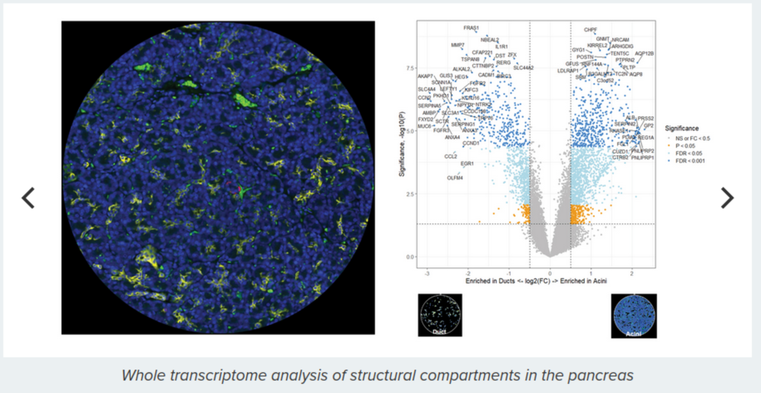
Data views (Volcano plot)

Slide 27
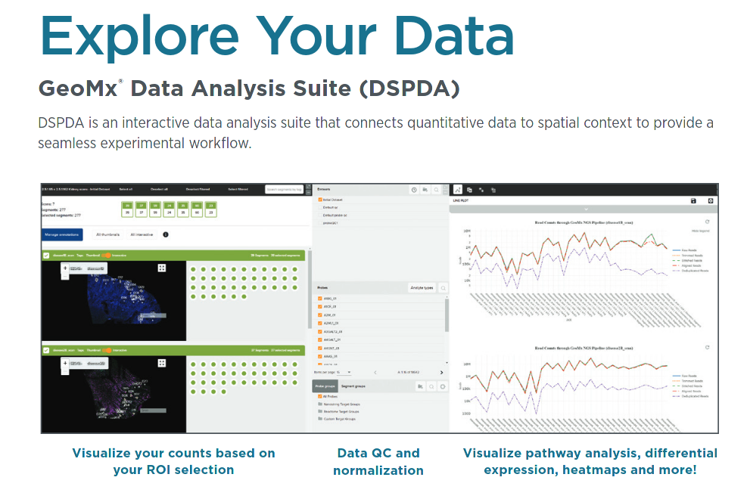

Slide 28
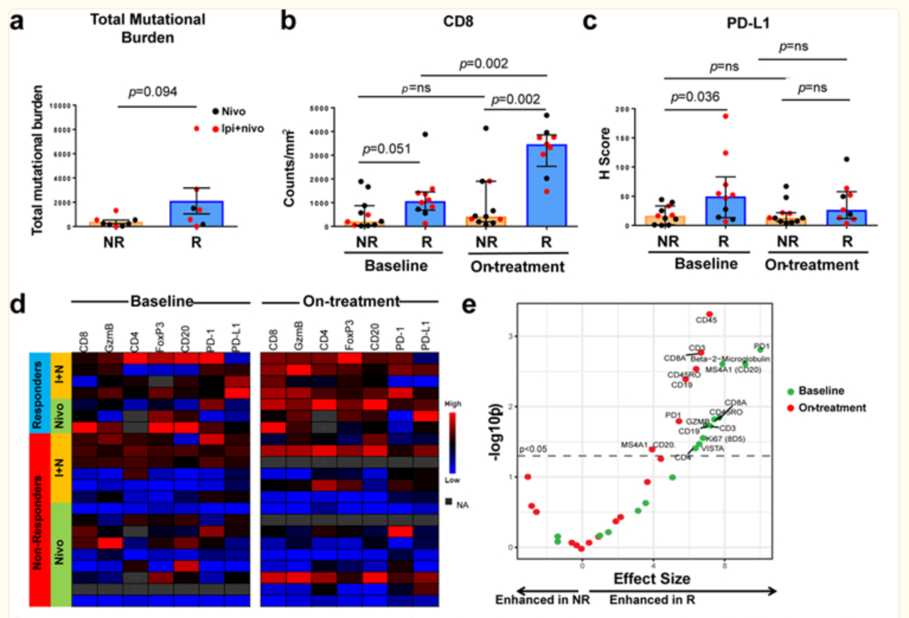
a: TMB greater in responders than in non-responders.
b: CD8 cell count density higher in responders than in non-responders at baseline and early on-treatment.
c: PD-L1 expression greater in responders than in non-responders at baseline and early on-treatment .
d: greater expression of lymphoid markers (Granzyme B, CD4, FoxP3, CD20, and PD-1) in responders than in non-responders at baseline and early-on treatment.
e: immune markers expression significantly (p.val < 0.05) greater in responders than in non-responders both at baseline and early on-treatment.

